Slide 1
Heritability Estimation of Dichotomous phenotypes Using a Liability Threshold Model on Ascertained Family-based Samples
Statistical Genetics and Network Science Meeting
Wonji Kim
Jan 23, 2019

Slide 2

Heritability
Introduction
Variation
in height
Height
Notes:
Variation of traits due to genetic factor

Slide 3

Heritability
Introduction
Height
Age
Notes:
Variation of traits due to genetic factor

Slide 4
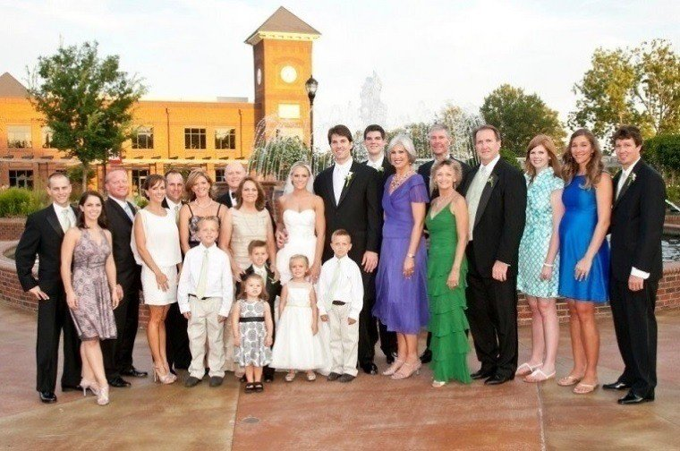
Heritability
Introduction
Notes:
Variation of traits due to genetic factor

Slide 5
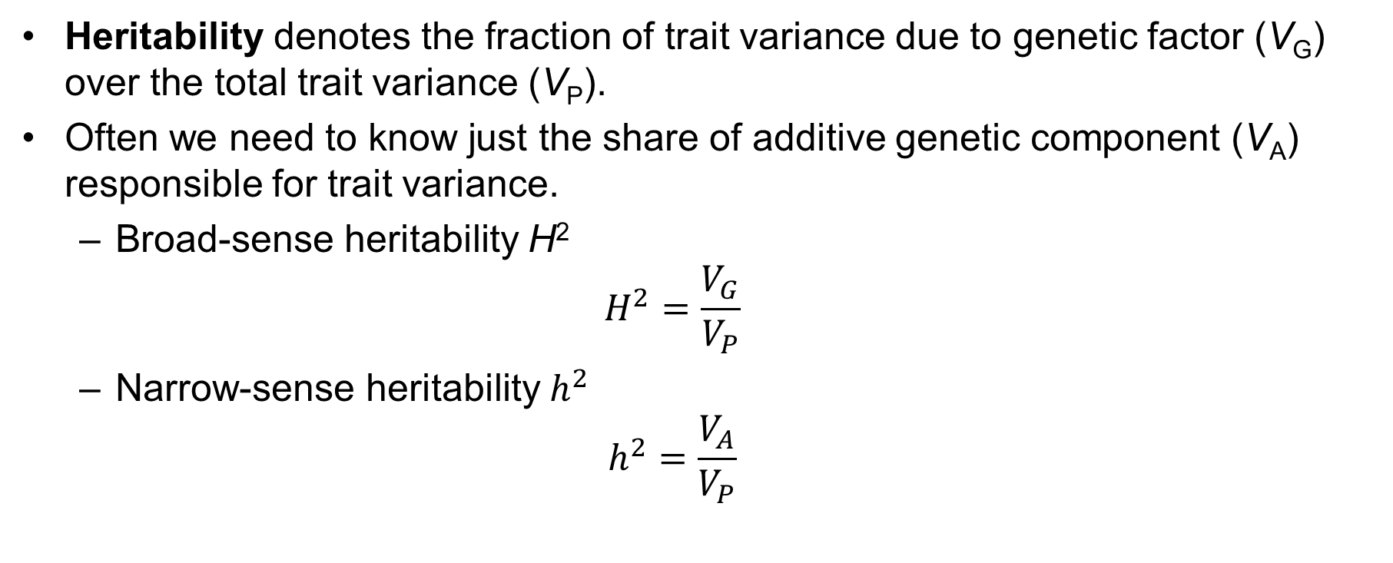
Heritability
Introduction
Heritability denotes the fraction of trait variance due to genetic factor (V_{G}) over the total trait variance (V_{P}).
Often we need to know just the share of additive genetic component (V_{A}) responsible for trait variance.
Broad-sense heritability H²
$$H^{2}=\frac{V_{G}}{V_{P}}$$
Narrow-sense heritability $h^{2}$
$$h^{2}=\frac{V_{A}}{V_{P}}$$
Notes:
Meaning of heritability& its use

Slide 6
Recent Improvements
Introduction
Estimation of heritability on binary traits
Linear Mixed Model (LMM) : GCTA, ...
Generalized Linear Mixed Model (GLMM) : BVC (logit), Gibbs sampling, ...
Bayesian approach : Beta-binomial, ...
Liability Threshold Model (LTM) : ACE model, SOLAR, ...

Slide 7
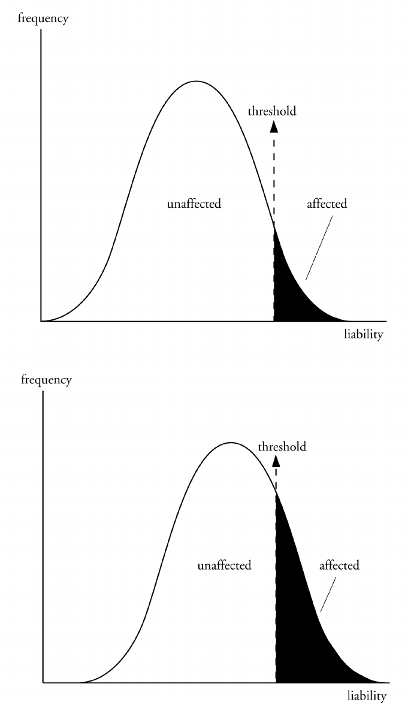
Liability Threshold Model (LTM)
Introduction
Liability is a term used to describe all the genetic and environmental factors that contribute to the development of a multifactorial disorder.
A lot of multifactorial traits display continuous variation such as height and intelligence.
However, some multifactorial disorders such as diabetes mellitus and cancer display discontinuous variation with individuals either being affected or not.
The threshold model allows this phenomenon to be explained.

Slide 8
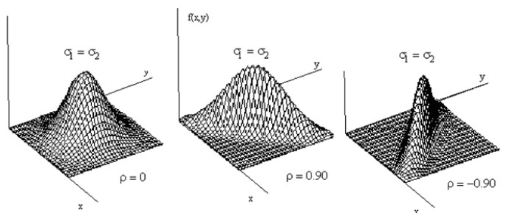
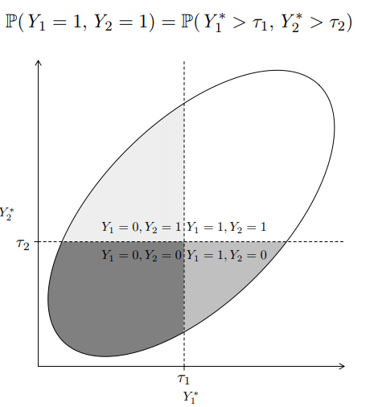
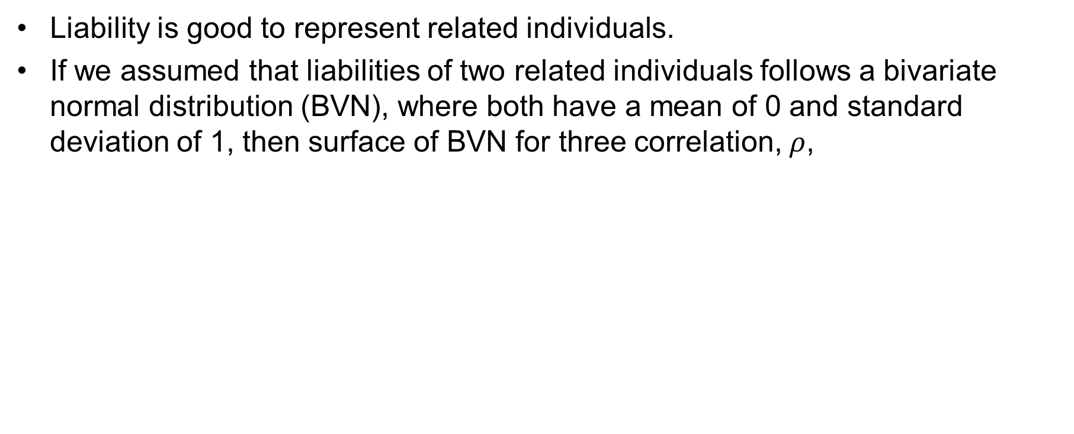
Liability Threshold Model (LTM)
Introduction
Liability is good to represent related individuals.
If we assumed that liabilities of two related individuals follows a bivariate normal distribution (BVN), where both have a mean of 0 and standard deviation of 1, then surface of BVN for three correlation, $ρ$,

Slide 9
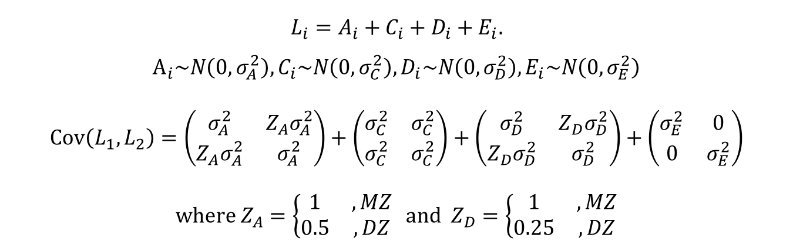
Heritability in Liability Threshold Model
Introduction
Polygenic model for bivariate liabilities of twin (ACE model)
Neale, M. C. C. L., & Cardon, L. R. (2013). Methodology for genetic studies of twins and families (Vol. 67). Springer Science & Business Media

Slide 10
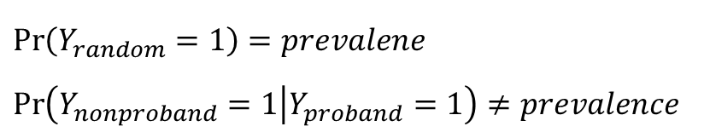
Ascertainment bias
Introduction
Family-based samples are typically analyzed using probands.
In these studies, an estimate of the proportion of relatives with the disease will be inflated than population prevalence.
GCTA adjusts estimated heritability by assuming that the level of ascertainment bias is same among individuals.
However, families are ascertained with probands and the effect of ascertainment bias is heterogeneous according to familial relationship.
Notes:
the term proband refers to instances when family members are brought into a study as a result of other family members already enrolled in the study.

Slide 11
Purpose of This Study
Introduction
The proposed method could
jointly estimate maximum likelihood estimators for heritability and coefficients of covariates simultaneously
adjust ascertainment bias by maximizing the conditional likelihood of disease statuses of probands via a conditional EM algorithm
perform statistical testing using conditional expected score test

Slide 12
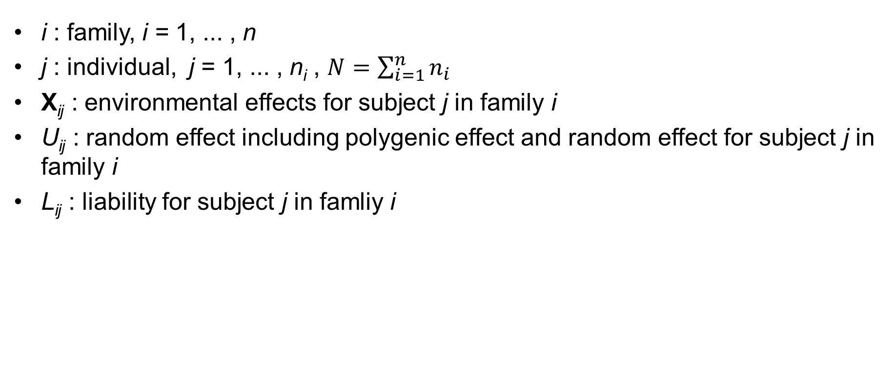
Notations
Method
Notations and the disease model
Estimation of the parameters using the EM algorithm
Conditional expected score test
i : family, i = 1, ... , n
j : individual, j = 1, ... , n_{i} , $N=\sum_{i=1}^{n}{n_{i}}$
X_{ij} : environmental effects for subject j in family i
U_{ij} : random effect including polygenic effect and random effect for subject j in family i
L_{ij} : liability for subject j in famliy i

Slide 13
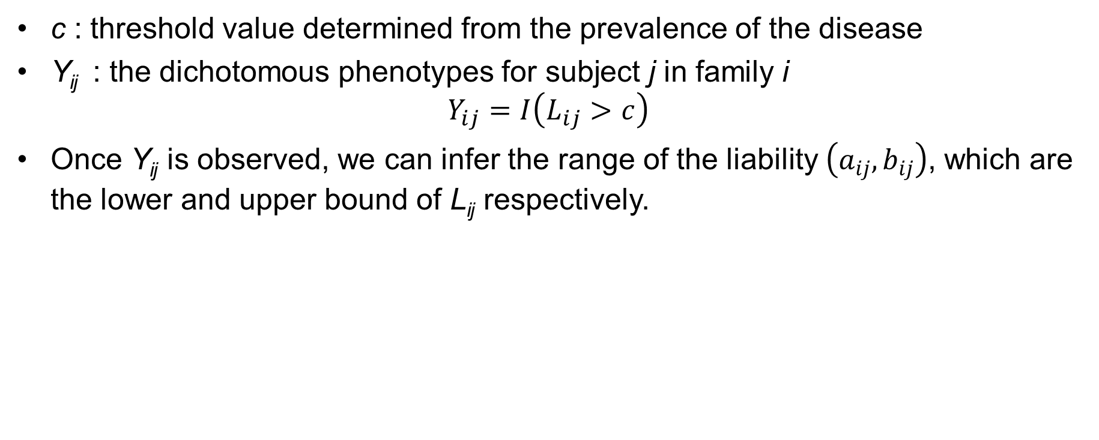
Notations
Method
Notations and the disease model
Estimation of the parameters using the EM algorithm
Conditional expected score test
c : threshold value determined from the prevalence of the disease
Y_{ij} : the dichotomous phenotypes for subject j in family i $Y_{ij}=I\left(L_{ij}>c\right)$
Once Y_{ij} is observed, we can infer the range of the liability $\left(a_{ij},b_{ij}\right)$, which are the lower and upper bound of L_{ij} respectively.

Slide 14
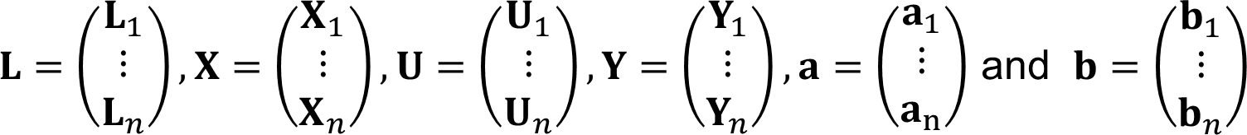
Notations
Method
Notations and the disease model
Estimation of the parameters using the EM algorithm
Conditional expected score test
Vector form

Slide 15
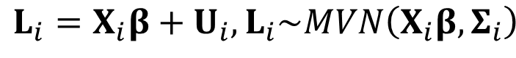
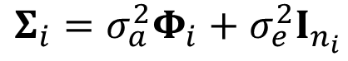
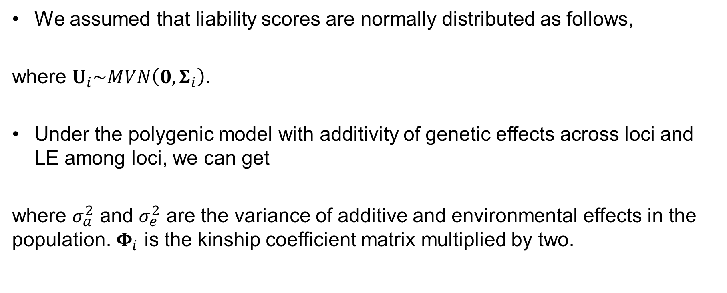
Disease Model
Method
Notations and the disease model
Estimation of the parameters using the EM algorithm
Conditional expected score test
We assumed that liability scores are normally distributed as follows,
where $U_{i}\sim MVN\left(0,Σ_{i}\right)$.
Under the polygenic model with additivity of genetic effects across loci and LE among loci, we can get
where $σ_{a}^{2}$ and $σ_{e}^{2}$ are the variance of additive and environmental effects in the population. $Φ_{i}$ is the kinship coefficient matrix multiplied by two.

Slide 16
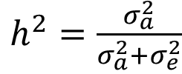
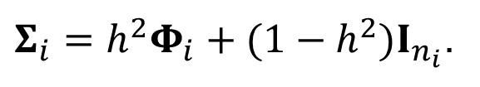
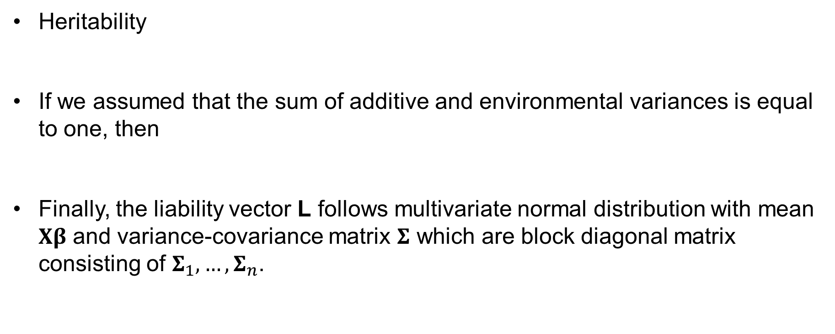
Disease Model
Method
Notations and the disease model
Estimation of the parameters using the EM algorithm
Conditional expected score test
Heritability
If we assumed that the sum of additive and environmental variances is equal to one, then
Finally, the liability vector L follows multivariate normal distribution with mean $Xβ$ and variance-covariance matrix $Σ$ which are block diagonal matrix consisting of $Σ_{1},…, Σ_{n}$.

Slide 17


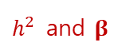
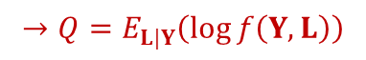
Estimation of the parameters
Method
Notations and the disease model
Estimation of the parameters using the EM algorithm
Conditional expected score test
EM algorithm (Dempster et al., 1977) : an iterative method to find maximum likelihood estimates of parameters in statistical models, where the model depends on unobserved latent variables.
Procedure
Define complete data consisting of observed variable & unobserved (missing, latent) variable
Obtain the joint log likelihood function of observed and unobserved variables
Take conditional expectation given observed variable to the joint log likelihood function and denote it as Q
Calculate maximizer of Q with respect to the parameter of interest
Update Step 3, 4 and iterate until convergence
$$Y$$
$$L$$
$$→Q=E_{L|Y}\left(\log{f\left(Y,L\right)}\right)$$
$h^{2}$ and $β$

Slide 18
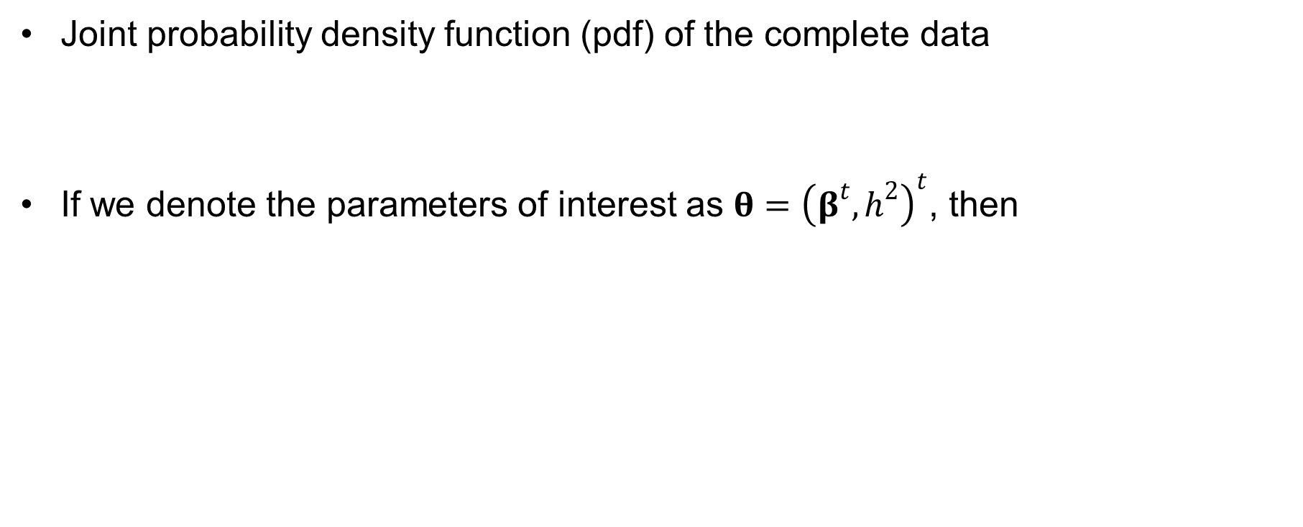
Estimation of the parameters
Method
Notations and the disease model
Estimation of the parameters using the EM algorithm
Conditional expected score test
Joint probability density function (pdf) of the complete data
If we denote the parameters of interest as $θ={\left(β^{t},h^{2}\right)}^{t}$, then

Slide 19
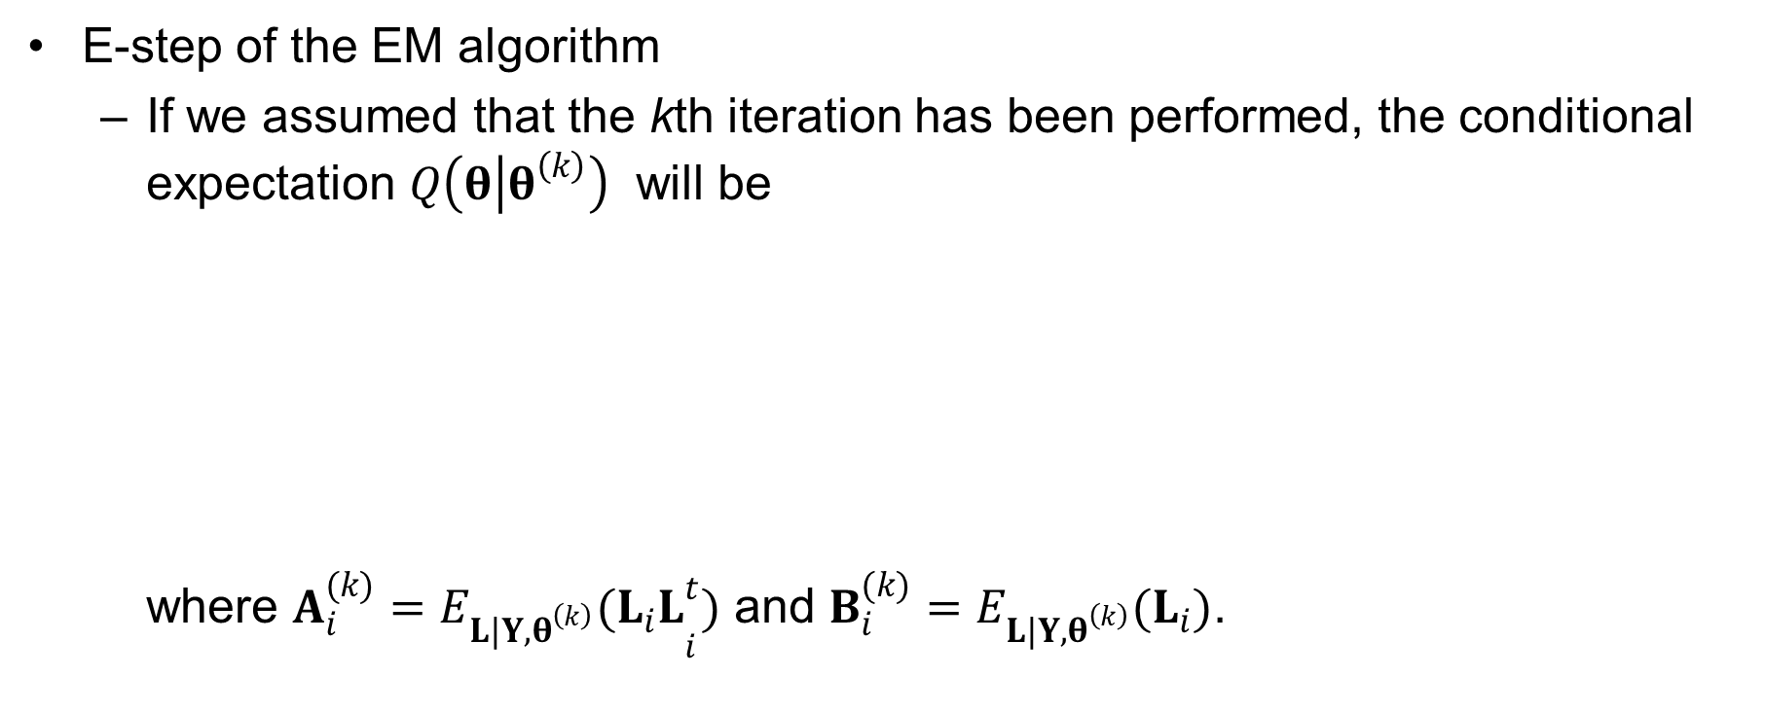
Estimation of the parameters
Method
Notations and the disease model
Estimation of the parameters using the EM algorithm
Conditional expected score test
E-step of the EM algorithm
If we assumed that the kth iteration has been performed, the conditional expectation $Q\left(θ | θ^{\left(k\right)}\right)$ will be where $A_{i}^{(k)}={E_{L|Y,θ^{\left(k\right)}}(L_{i}L}_{i}^{t})$ and $B_{i}^{(k)}=E_{L|Y,θ^{\left(k\right)}}(L_{i})$.

Slide 20
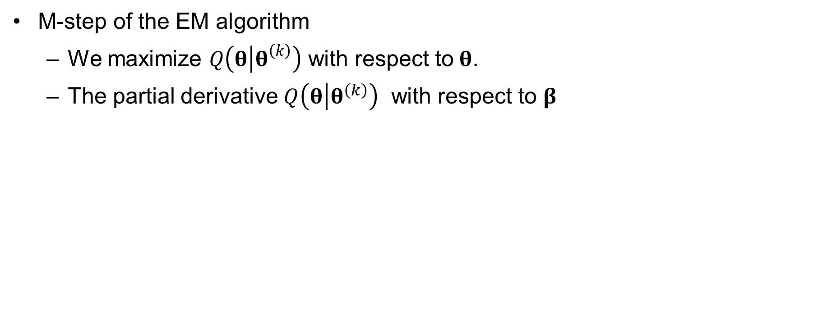
Estimation of the parameters
Method
Notations and the disease model
Estimation of the parameters using the EM algorithm
Conditional expected score test
M-step of the EM algorithm
We maximize $Q\left(θ | θ^{\left(k\right)}\right)$ with respect to$θ$.
The partial derivative $Q\left(θ | θ^{\left(k\right)}\right)$ with respect to $β$

Slide 21
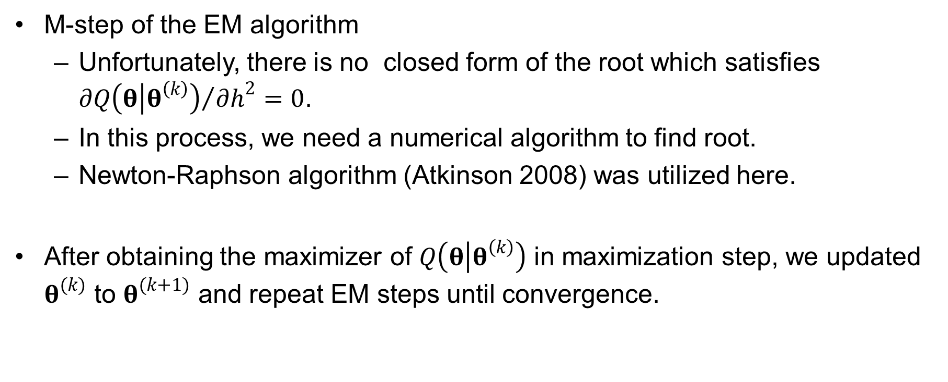
Estimation of the parameters
Method
Notations and the disease model
Estimation of the parameters using the EM algorithm
Conditional expected score test
M-step of the EM algorithm
Unfortunately, there is no closed form of the root which satisfies ${∂Q\left(θ | θ^{\left(k\right)}\right)}/{∂h^{2}}=0$.
In this process, we need a numerical algorithm to find root.
Newton-Raphson algorithm (Atkinson 2008) was utilized here.
After obtaining the maximizer of $Q\left(θ | θ^{\left(k\right)}\right)$ in maximization step, we updated $θ^{(k)}$ to $θ^{(k+1)}$ and repeat EM steps until convergence.

Slide 22
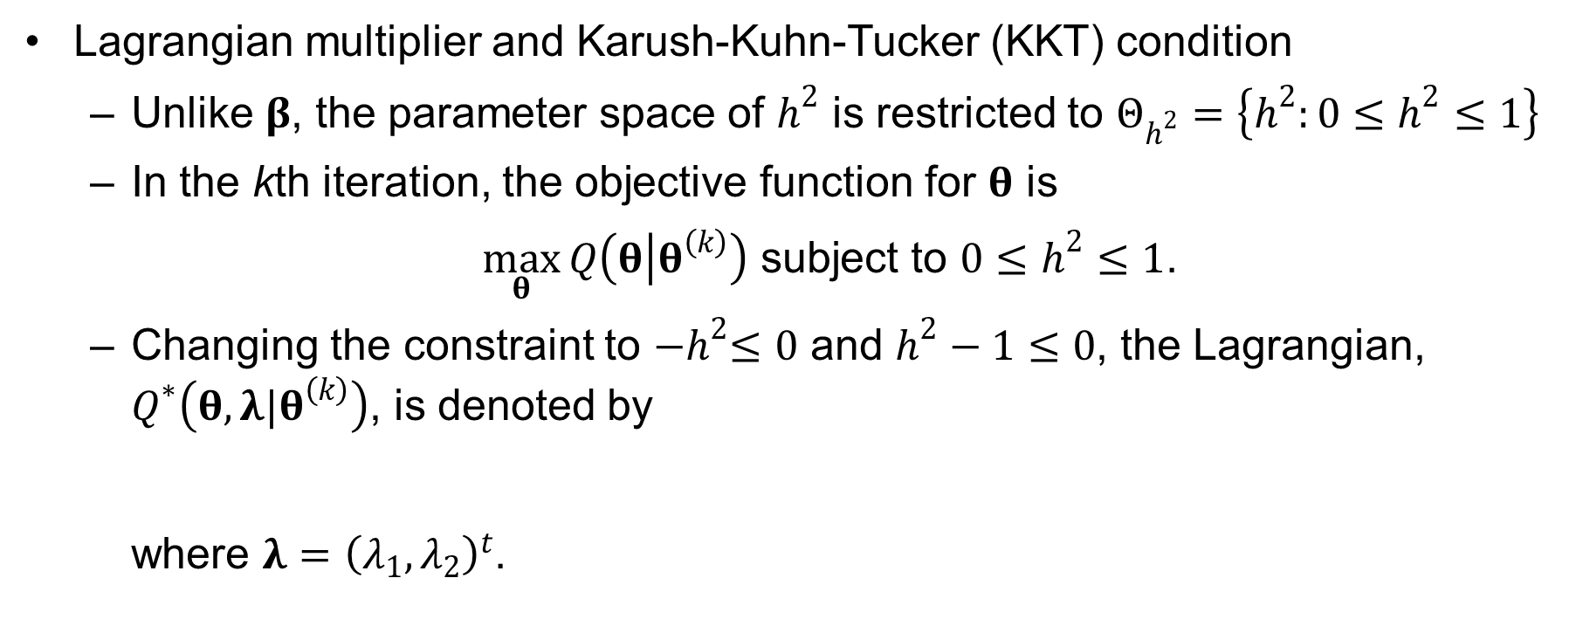
Estimation of the parameters
Method
Notations and the disease model
Estimation of the parameters using the EM algorithm
Conditional expected score test
Lagrangian multiplier and Karush-Kuhn-Tucker (KKT) condition
Unlike $β$, the parameter space of $h^{2}$ is restricted to $Θ_{h^{2}}=\left\{h^{2}:0≤h^{2}≤1\right\}$
In the kth iteration, the objective function for $θ$ is
$\max_{θ}{Q\left(θ | θ^{\left(k\right)}\right)}$ subject to $0≤h^{2}≤1$.
Changing the constraint to ${−h}^{2}≤0$ and $h^{2}−1≤0$, the Lagrangian, $Q^{∗}\left(θ,λ|θ^{\left(k\right)}\right)$, is denoted by where $λ={\left(λ_{1},λ_{2}\right)}^{t}$.

Slide 23
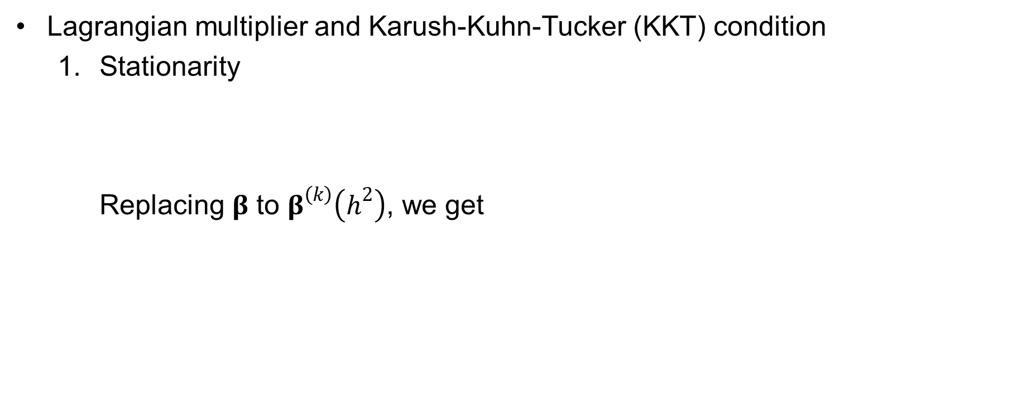
Estimation of the parameters
Method
Notations and the disease model
Estimation of the parameters using the EM algorithm
Conditional expected score test
Lagrangian multiplier and Karush-Kuhn-Tucker (KKT) condition
Stationarity Replacing $β$ to $β^{\left(k\right)}\left(h^{2}\right)$, we get

Slide 24
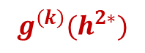
Estimation of the parameters
Method
Notations and the disease model
Estimation of the parameters using the EM algorithm
Conditional expected score test
Lagrangian multiplier and Karush-Kuhn-Tucker (KKT) condition
Stationarity
and it is equivalent to
$$g^{\left(k\right)}(h^{2∗})$$

Slide 25
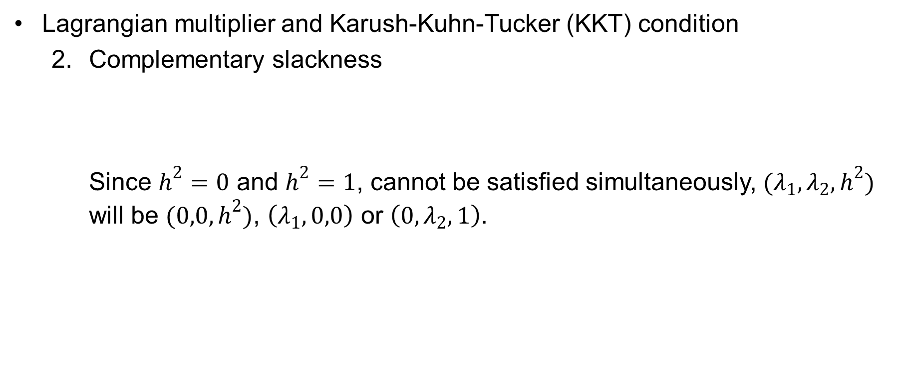
Estimation of the parameters
Method
Notations and the disease model
Estimation of the parameters using the EM algorithm
Conditional expected score test
Lagrangian multiplier and Karush-Kuhn-Tucker (KKT) condition
Complementary slackness Since $h^{2}=0$ and $h^{2}=1$, cannot be satisfied simultaneously, $(λ_{1},λ_{2},h^{2})$ will be $(0,0,h^{2})$, $\left(λ_{1},0,0\right)$ or $\left(0,λ_{2},1\right)$.

Slide 26
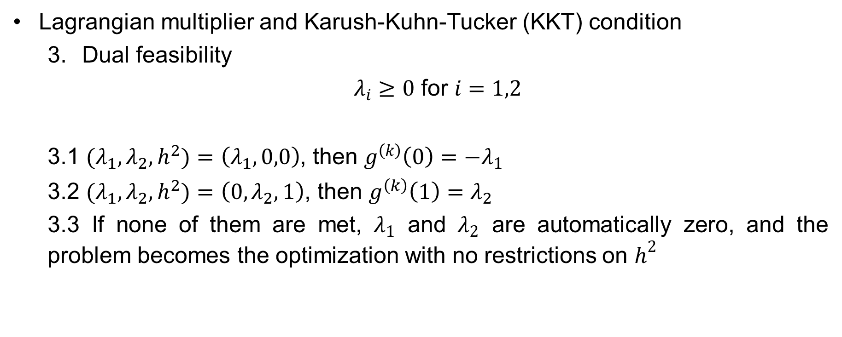
Estimation of the parameters
Method
Notations and the disease model
Estimation of the parameters using the EM algorithm
Conditional expected score test
Lagrangian multiplier and Karush-Kuhn-Tucker (KKT) condition
Dual feasibility
$λ_{i}≥0$ for $i=1,2$
3.1 $(λ_{1},λ_{2},h^{2})$ $=\left(λ_{1},0,0\right)$, then $g^{\left(k\right)}\left(0\right)={−λ}_{1}$
3.2 $(λ_{1},λ_{2},h^{2})$ $=\left(0,λ_{2},1\right)$, then $g^{\left(k\right)}\left(1\right)=λ_{2}$
3.3 If none of them are met, $λ_{1}$ and $λ_{2}$ are automatically zero, and the problem becomes the optimization with no restrictions on $h^{2}$

Slide 27
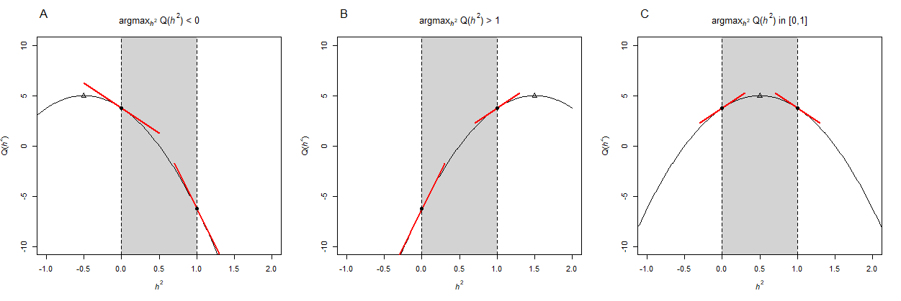
Estimation of the parameters
Method
Notations and the disease model
Estimation of the parameters using the EM algorithm
Conditional expected score test
Illustration of KKT condition using a toy example

Slide 28
Ascertainment Bias-corrected Heritability
Method
Notations and the disease model
Estimation of the parameters using the EM algorithm
Conditional expected score test
When Families are ascertained due to probands,
The conditional likelihood
The log of the conditional likelihood

Slide 29
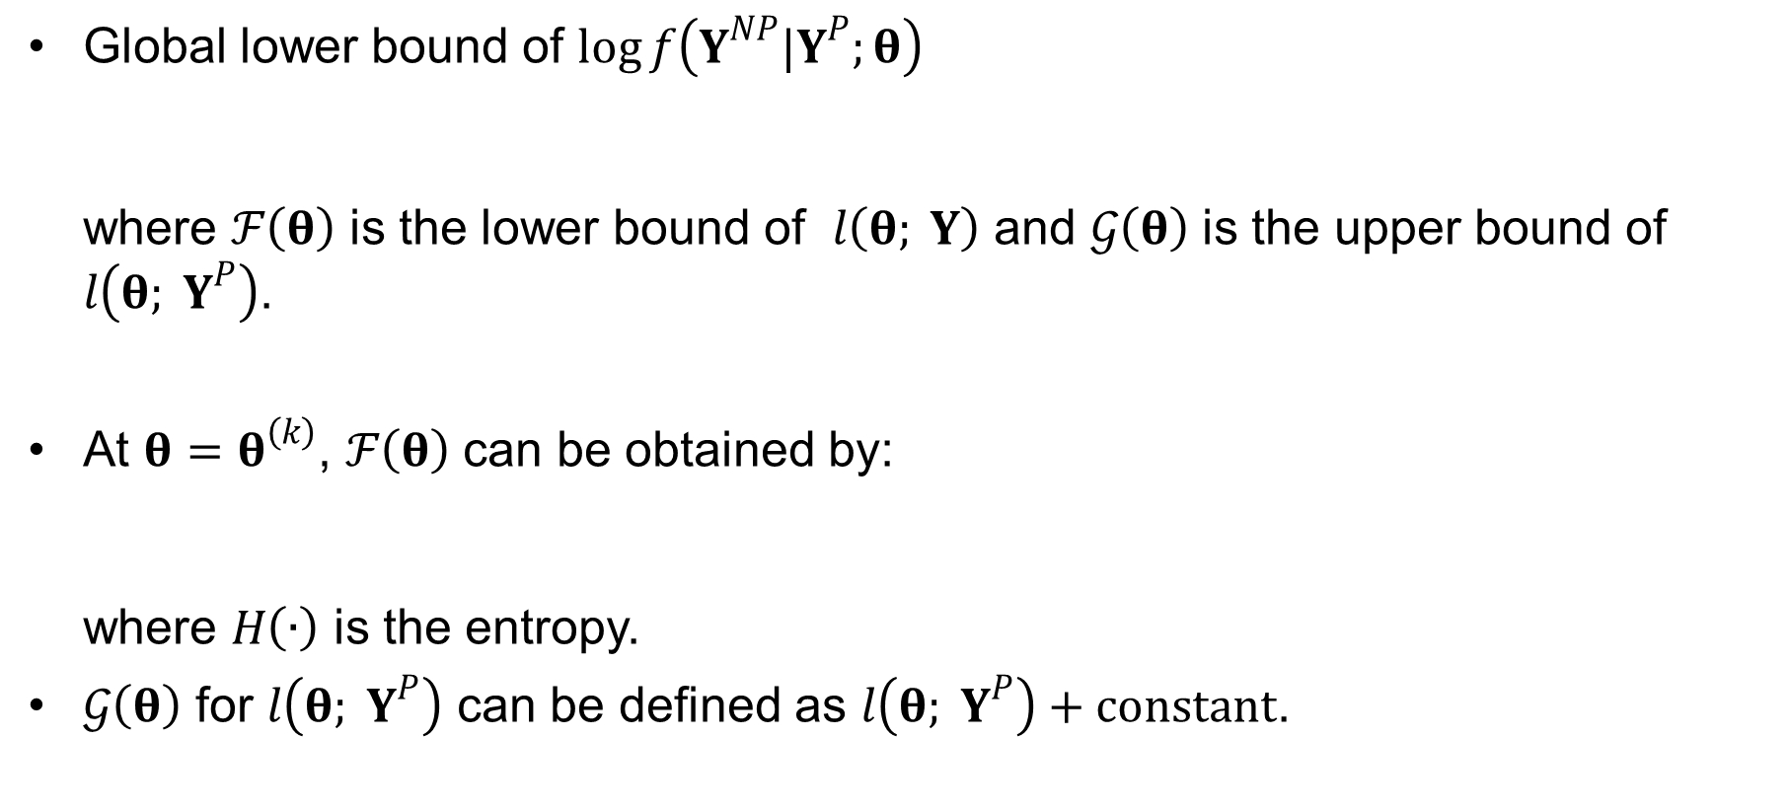
Ascertainment Bias-corrected Heritability
Method
Notations and the disease model
Estimation of the parameters using the EM algorithm
Conditional expected score test
Global lower bound of $\log{f\left(Y^{NP}|Y^{P};θ\right)}$ where $ℱ\left(θ\right)$ is the lower bound of $l\left(θ; Y\right)$ and $𝒢\left(θ\right)$ is the upper bound of $l\left(θ; Y^{P}\right)$.
At $θ=θ^{\left(k\right)}$, $ℱ\left(θ\right)$ can be obtained by: where $H\left(∙\right)$ is the entropy.
$𝒢\left(θ\right)$ for $l\left(θ; Y^{P}\right)$ can be defined as $l\left(θ; Y^{P}\right)+constant$.

Slide 30
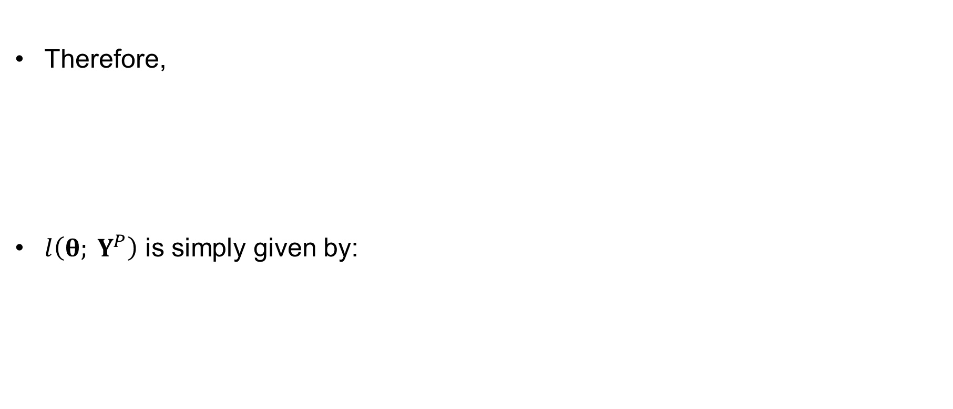
Ascertainment Bias-corrected Heritability
Method
Notations and the disease model
Estimation of the parameters using the EM algorithm
Conditional expected score test
Therefore,
$l\left(θ; Y^{P}\right)$ is simply given by:
Expectation step of EM algorithm for randomly selected families
Generalized linear model

Slide 31
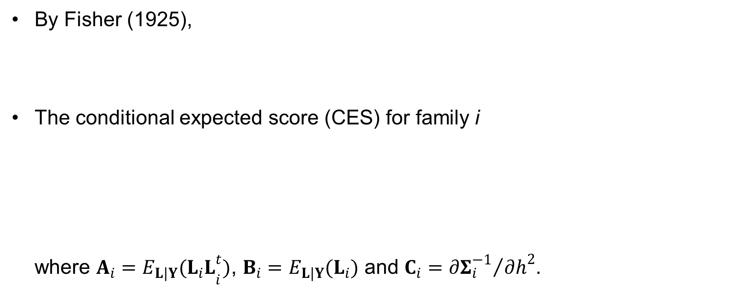
Conditional Expected Score Test (CEST)
Method
Notations and the disease model
Estimation of the parameters using the EM algorithm
Conditional expected score test
By Fisher (1925),
The conditional expected score (CES) for family i where $A_{i}={E_{L|Y}(L_{i}L}_{i}^{t})$, $B_{i}=E_{L|Y}(L_{i})$ and $C_{i}={∂Σ_{i}^{−1}}/{∂h^{2}}$.

Slide 32
Conditional Expected Score Test (CEST)
Method
Notations and the disease model
Estimation of the parameters using the EM algorithm
Conditional expected score test
The observed Fisher information matrix is given by and it is equivalent to

Slide 33
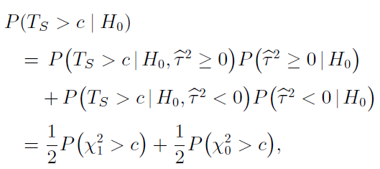
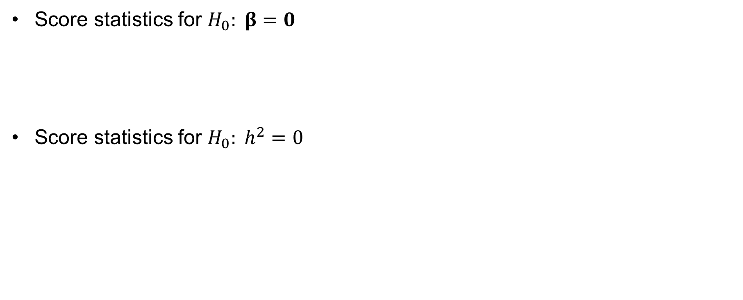
Conditional Expected Score Test (CEST)
Method
Notations and the disease model
Estimation of the parameters using the EM algorithm
Conditional expected score test
Score statistics for $H_{0}: β=0$
Score statistics for $H_{0}: h^{2}=0$

Slide 34
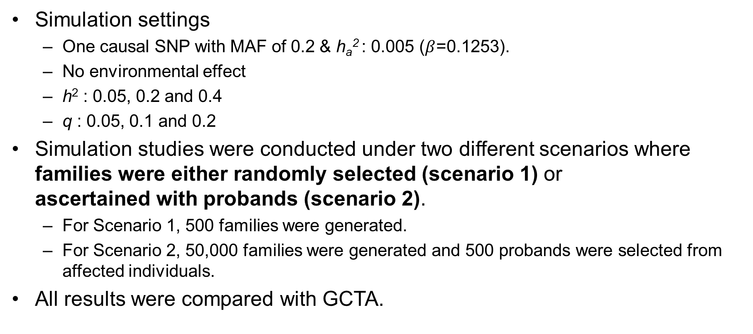
Simulation Settings
Result
Simulation study
Application to heritability estimation of T2D
Application to GWAS of S-LAM
Simulation settings
One causal SNP with MAF of 0.2 & h_{a}² : 0.005 ($β$=0.1253).
No environmental effect
h² : 0.05, 0.2 and 0.4
q : 0.05, 0.1 and 0.2
Simulation studies were conducted under two different scenarios where families were either randomly selected (scenario 1) or ascertained with probands (scenario 2).
For Scenario 1, 500 families were generated.
For Scenario 2, 50,000 families were generated and 500 probands were selected from affected individuals.
All results were compared with GCTA.

Slide 35
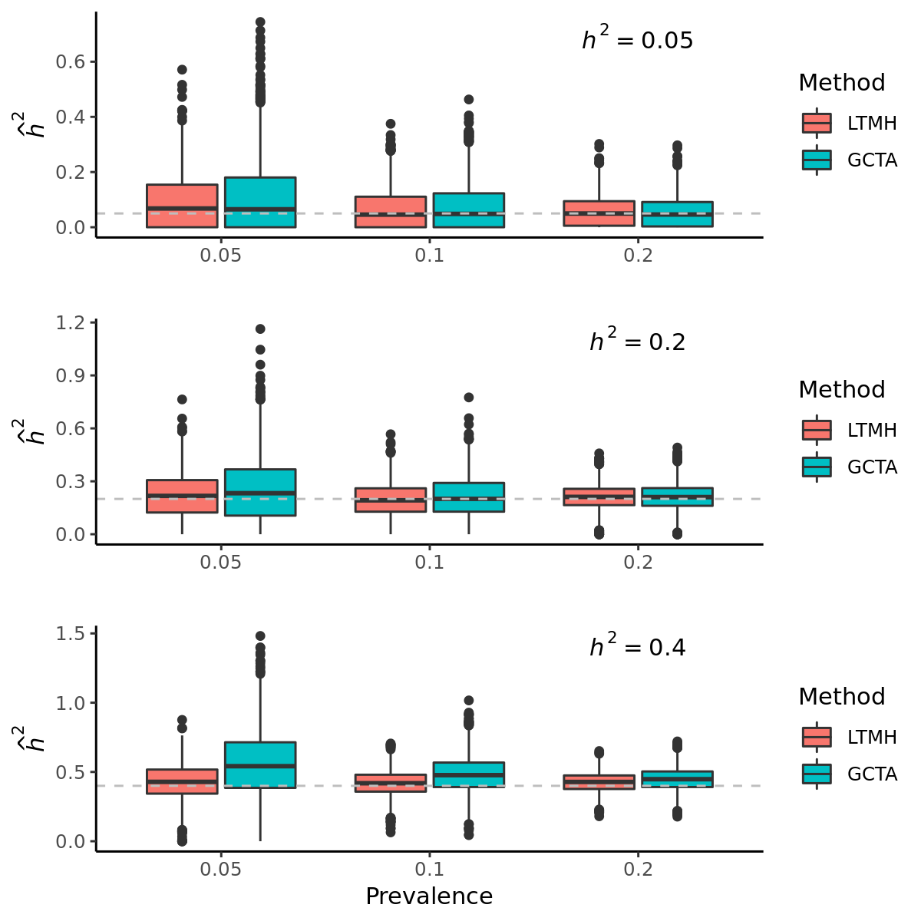
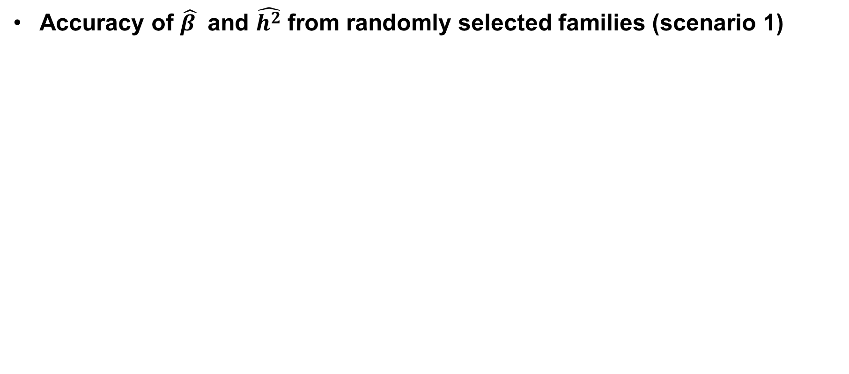
Simulation study (2,000 replicates)
Result
Simulation study
Application to heritability estimation of T2D
Application to GWAS of S-LAM
Accuracy of $\hat{β }$ and $\hat{h^{2}}$ from randomly selected families (scenario 1)

Slide 36
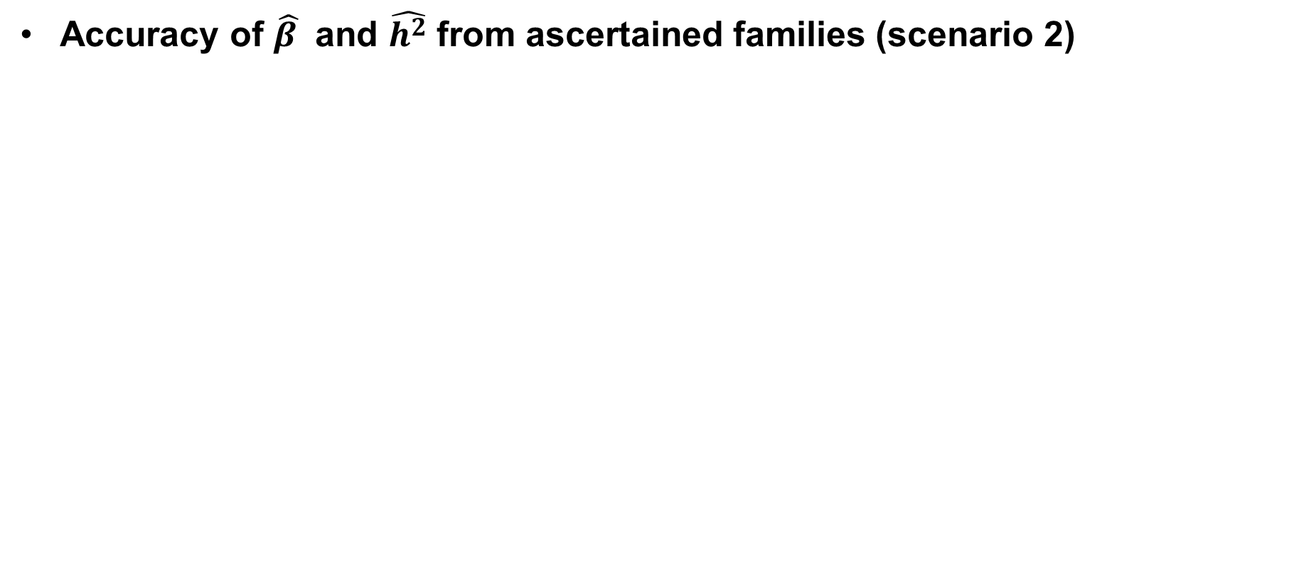
Simulation study (2,000 replicates)
Result
Simulation study
Application to heritability estimation of T2D
Application to GWAS of S-LAM
Accuracy of $\hat{β }$ and $\hat{h^{2}}$ from ascertained families (scenario 2)

Slide 37
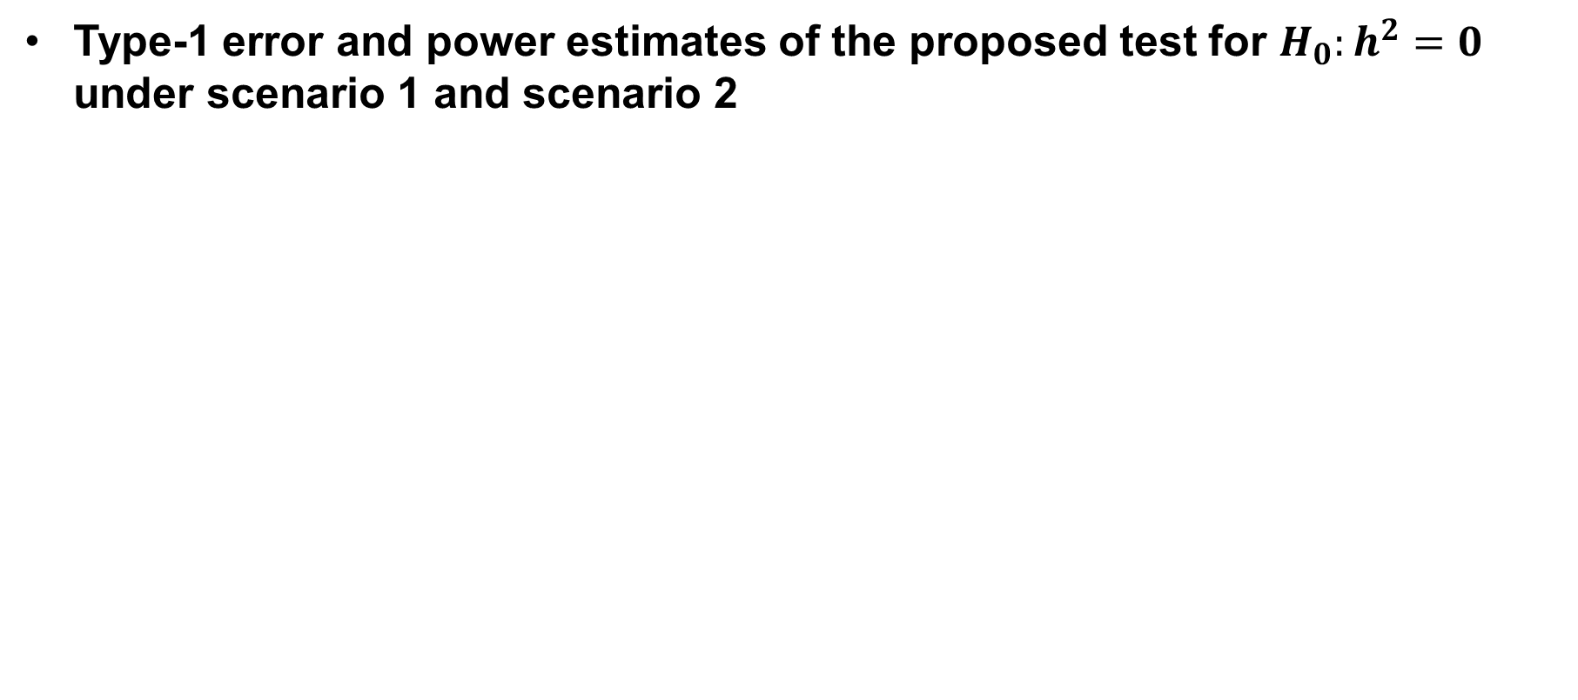
Simulation study (2,000 replicates)
Result
Simulation study
Application to heritability estimation of T2D
Application to GWAS of S-LAM
Type-1 error and power estimates of the proposed test for $H_{0}:h^{2}=0$ under scenario 1 and scenario 2
Randomly selected family (Scenario 1)
Ascertained family (Scenario 2)

Slide 38
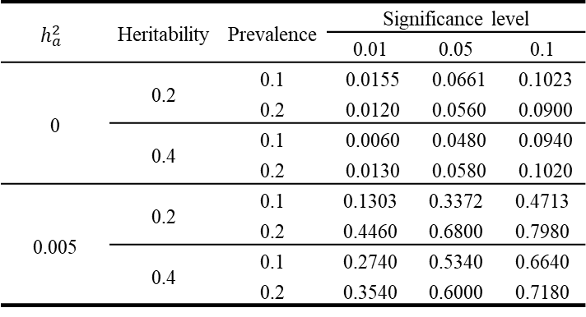
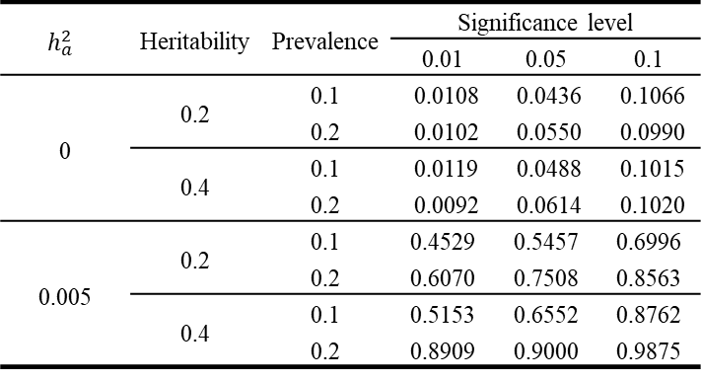
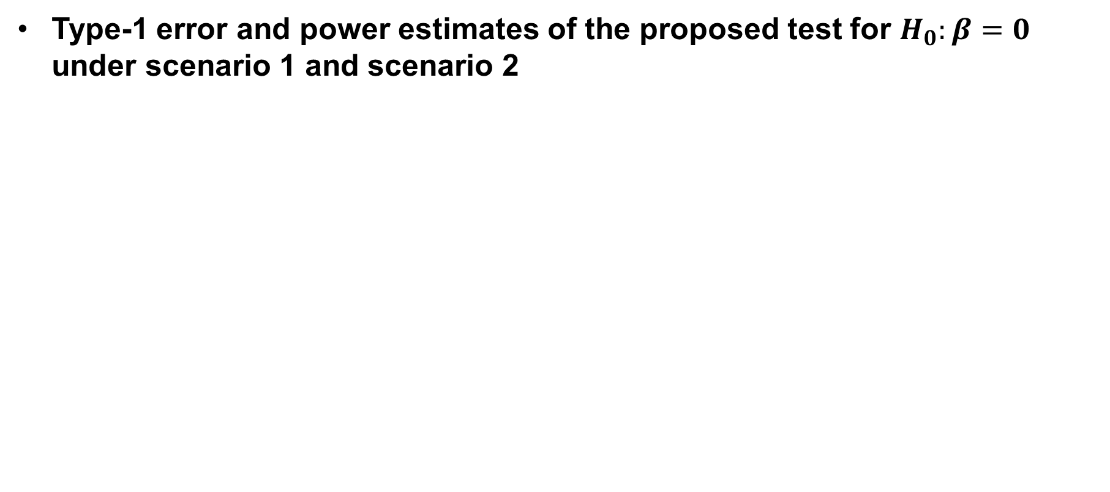
Simulation study (2,000 replicates)
Result
Simulation study
Application to heritability estimation of T2D
Application to GWAS of S-LAM
Type-1 error and power estimates of the proposed test for $H_{0}:β=0$ under scenario 1 and scenario 2
Randomly selected family (Scenario 1)
Ascertained family (Scenario 2)

Slide 39
Real data analysis (T2D)
Result
Simulation study
Application to heritability estimation of T2D
Application to GWAS of S-LAM
Applications of LTMH and CEST to T2D
Seoul national university hospital recruited 681 probands affected to T2D.
This study preferentially included T2D patients with a positive family history of T2D in first-degree relatives.
After excluding subjects without age information, we have 648 probands and 4,149 non-probands.

Slide 40
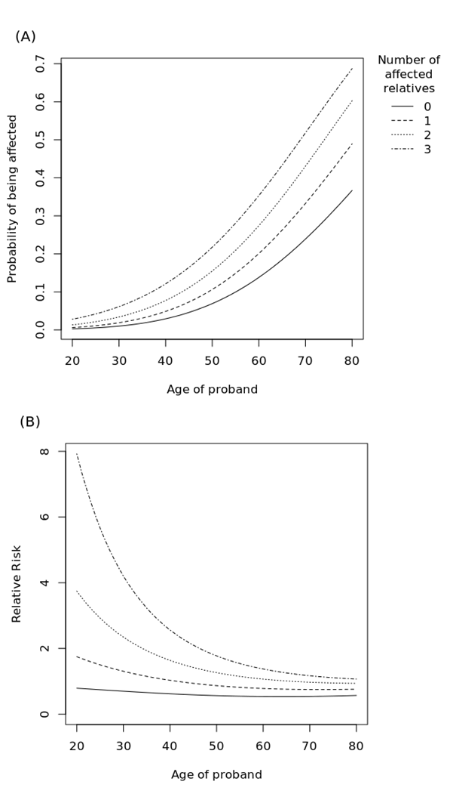
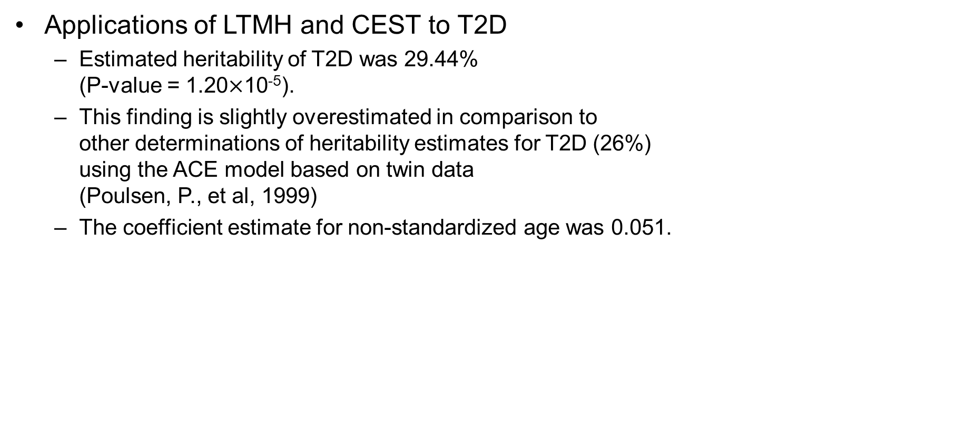
Real data analysis (T2D)
Result
Simulation study
Application to heritability estimation of T2D
Application to GWAS of S-LAM
Applications of LTMH and CEST to T2D
Estimated heritability of T2D was 29.44% (P-value = 1.20$×$10⁻⁵).
This finding is slightly overestimated in comparison to other determinations of heritability estimates for T2D (26%) using the ACE model based on twin data (Poulsen, P., et al, 1999)
The coefficient estimate for non-standardized age was 0.051.
Notes:
which means that the threshold for disease is reduced by 0.051 at the liability scale if age increases by 1.

Slide 41
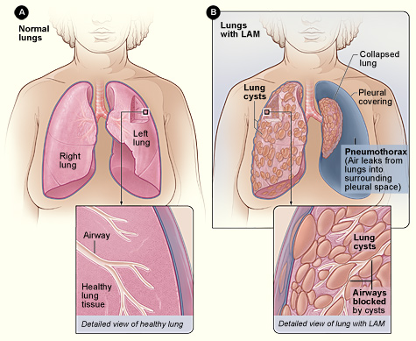
Real data analysis (S-LAM)
Result
Simulation study
Application to heritability estimation of T2D
Application to GWAS of S-LAM
Lymphangioleiomyomatosis (LAM) is a rare disease affecting women of child-bearing age, usually in their 30s and 40s.
sporadic LAM (S-LAM) : for patients with LAM not associated with tuberous sclerosis complex (TSC), TSC-LAM : LAM associated with TSC which is due to mutations in either TSC1 or TSC2.
Hypothesis : DNA sequence variants outside of TSC2/TSC1 might be associated with S-LAM

Slide 42
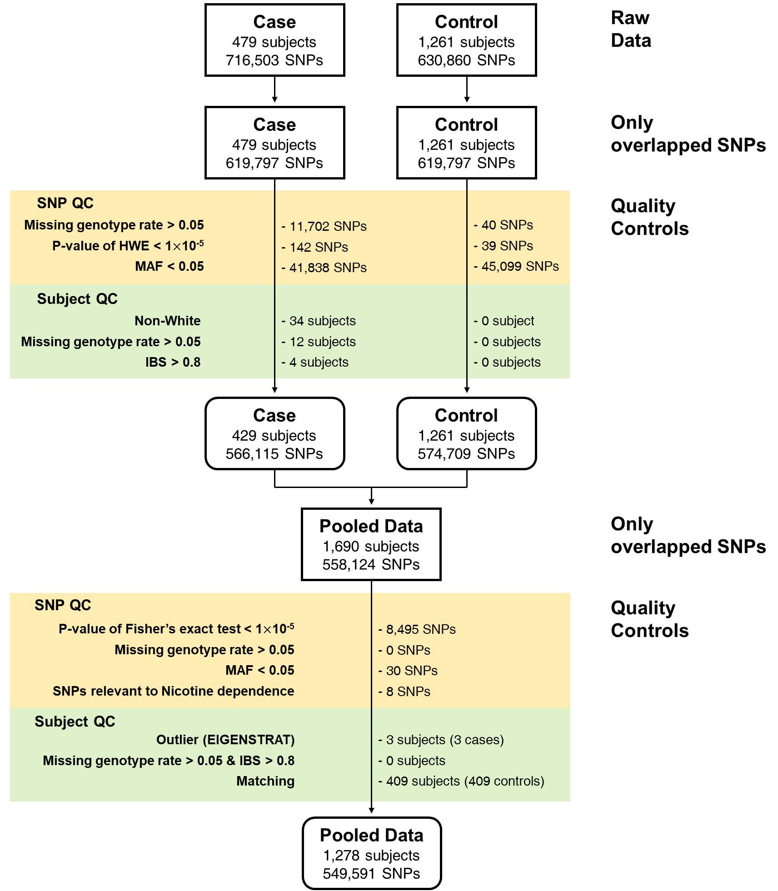
Real data analysis (S-LAM)
Result
Simulation study
Application to heritability estimation of T2D
Application to GWAS of S-LAM
Case S-LAM patients from 14 countries
Control Healthy women from COPDGene dataset
Method - Conditional logistic regression (CLR) using matched cases and controls (1:2). - Two PC scores with two largest eigenvalues and age were used for matching.

Slide 43
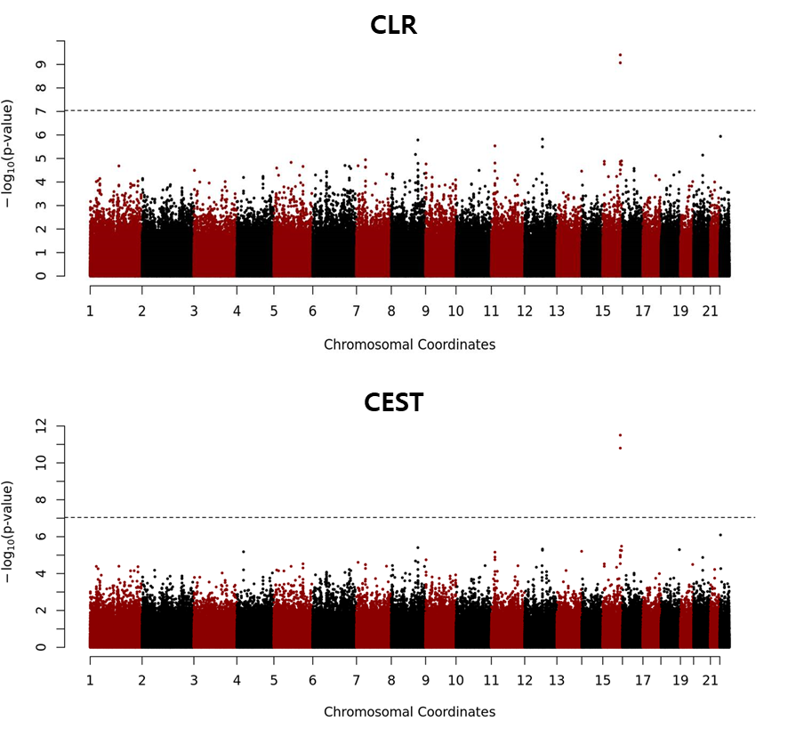
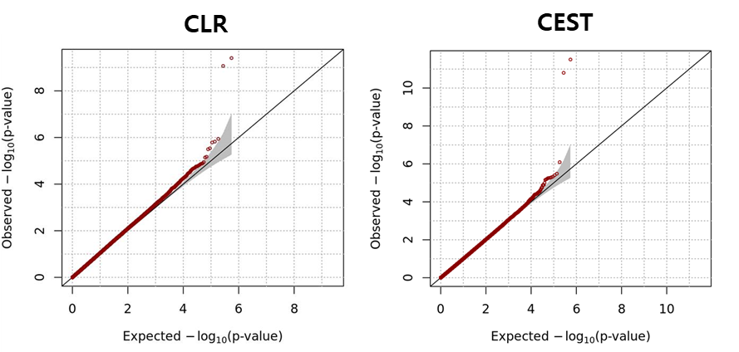
Application to GWAS of LAM
Result
Simulation study
Application to heritability estimation of T2D
Application to GWAS of S-LAM
Results

Slide 44
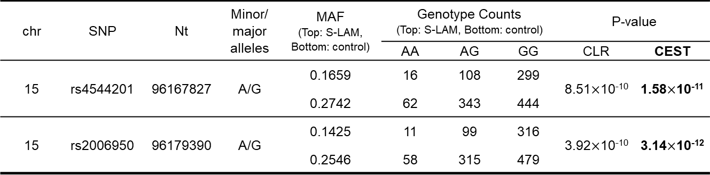
Application to GWAS of LAM
Result
Simulation study
Application to heritability estimation of T2D
Application to GWAS of S-LAM
Results
chr | SNP | Nt | Minor/ major alleles | MAF (Top: S-LAM, Bottom: control) | Genotype Counts (Top: S-LAM, Bottom: control) |  |  | P-value
 |  |  |  |  | AA | AG | GG | CLR | CEST
15 | rs4544201 | 96167827 | A/G | 0.1659 | 16 | 108 | 299 | 8.51$×$10⁻¹⁰ | 1.58$×$10⁻¹¹
 |  |  |  | 0.2742 | 62 | 343 | 444
15 | rs2006950 | 96179390 | A/G | 0.1425 | 11 | 99 | 316 | 3.92$×$10⁻¹⁰ | 3.14$×$10⁻¹²
 |  |  |  | 0.2546 | 58 | 315 | 479

Slide 45
Conclusion and Discussion
Conclusion and Discussion
In this study, I proposed a new method to estimate the heritability of a dichotomous trait based on the Liability Threshold Model for ascertained family-based samples.
A simulation study demonstrated that LTMH generally provides more accurate estimates of heritabilities than does GCTA, and the differences between these methods are substantial in the context of ascertained families.
Statistical performance of CEST analysis were also assessed. Despite of conservative property of CEST, I found that such inflation does not affect the statistical power of our analysis but certain modifications such as bootstrapping are necessary.

Slide 46
Conclusion and Discussion
Conclusion and Discussion
However, there is a limitation that the proposed method is computationally intensive when the family size is large.
The most significant computational burden arises from the calculation of conditional expectation in the E-step of the EM algorithm.
Therefore, the computational burden can be reduced by reducing the number of iterations for the EM algorithm or by approximating the moment of the multivariate truncated normal.
Despite several limitations, our proposed method successfully enabled heritability estimation of dichotomous traits in ascertained families, and this method may provide a promising strategy to estimate the narrow-sense heritability of various diseases.

Slide 47
Thank you

